Slide 1

01
SSB
INTERVIEW

Slide 2
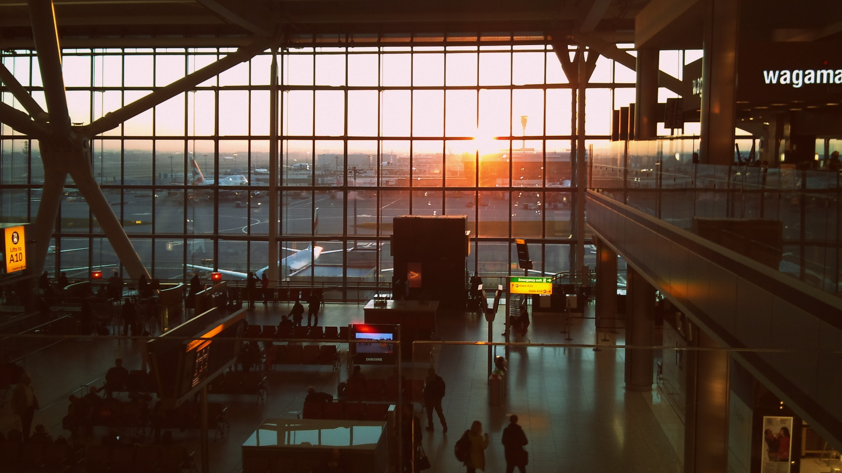
02
SSB centers
NSB Bhopal
NSB Bengaluru
NSB Visakhapatnam
NSB Kolkata, West Bengal

Slide 3
Process
03
Day 1
OIR
PPDT
Day 2
Psych test
IO
Day 3, Day 4
GTO
IO
Day 5
Conference

Slide 4
Day 1 (Screening test)
04
Officer Intelligence Rating test (OIR)
https://youtu.be/k7ZriRxDFQ0?si=yZice_gxtBADVM6H
Picture perception and Description Test (PPDT)

Slide 5
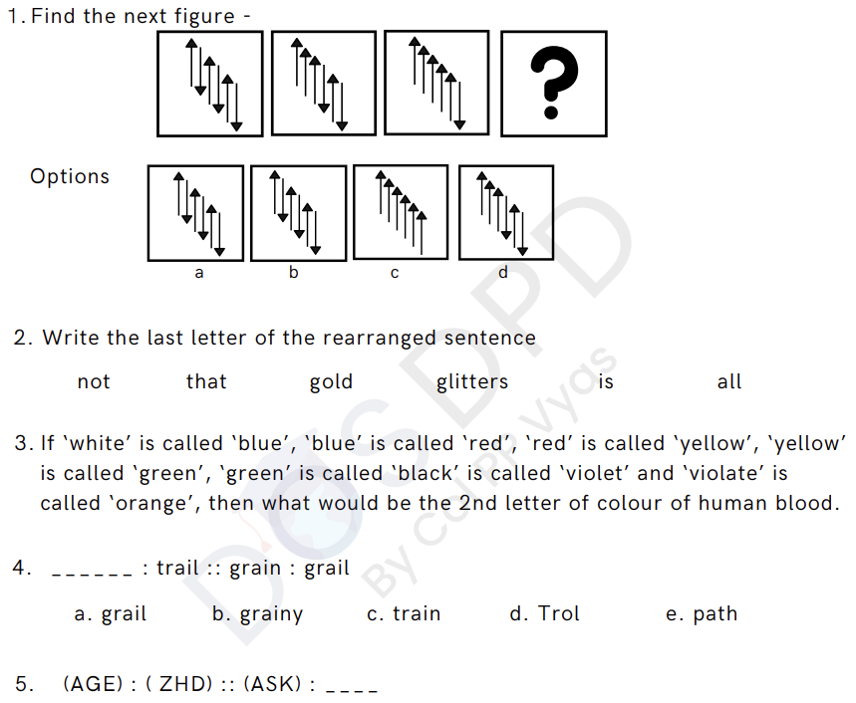
OIR TEST

Slide 6

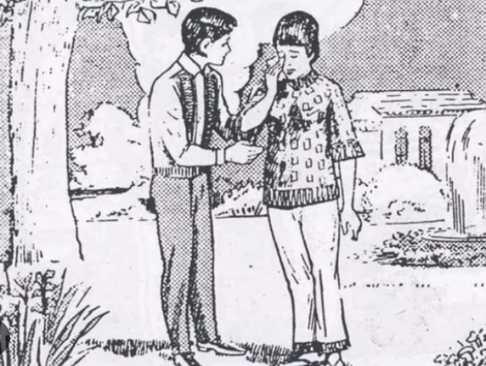

PPDT

Slide 7

Day 2
05
Psychology test :
Thematic Apperception Test (TAT)
Word Association Test (WAT)
Situation reaction Test (SRT)
Self Description (SD)
Interview

Slide 8
Day 3
06
GTO task
Phase 1:
Group Discussion (GD)
Group Planning Exercise (GPE)
Progressive Group Task (PGT)
Group Race Obstacle (Snake race)
Interview

Slide 9
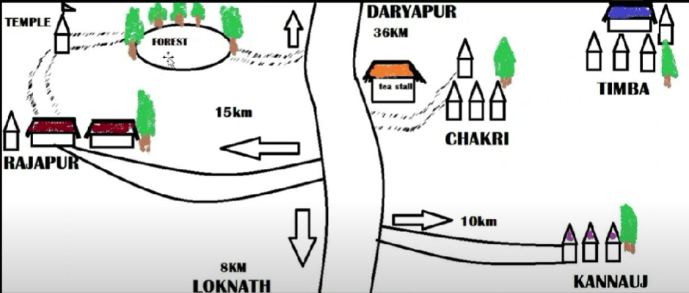
Group Discussion
Social Issues
Unemployment and Skill Development in India
Mental Health Awareness in Youth
The Impact of OTT Platforms on Indian Culture
What should be Indias priority today
Research, Development and manufacturing
Employment and education
Heathcare facilities and better farming subsidies
Group Planning Exercise

Slide 10
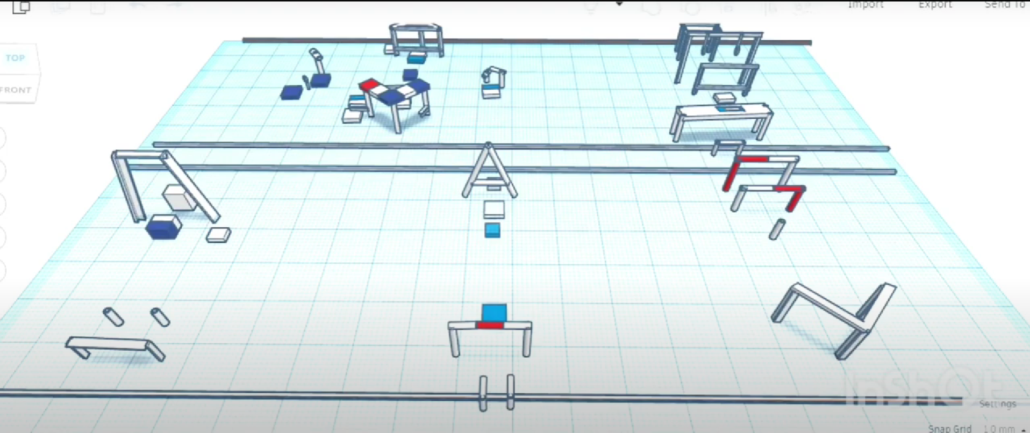
PGT

Slide 11
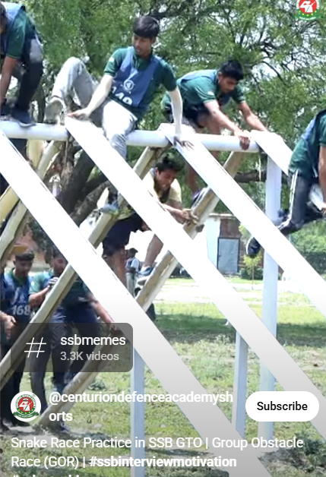
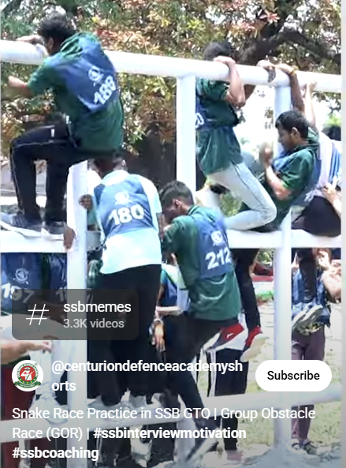


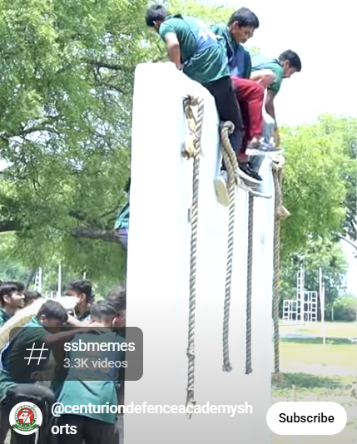

Group Race Obstacle (Snake Race)

Slide 12
Day 4
07
GTO task
Phase 2:
Half Group task (HGT)
Individual Obstacle
Lecturette
Command Task
Full Group task (FGT)
Interview

Slide 13
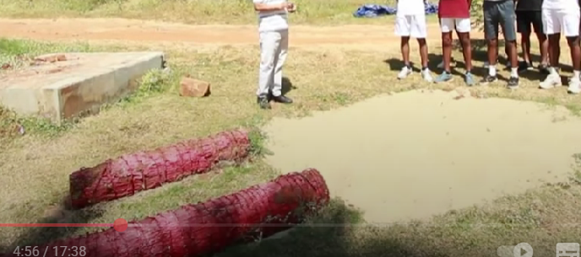
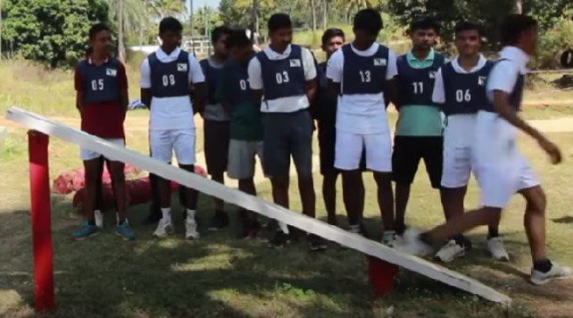
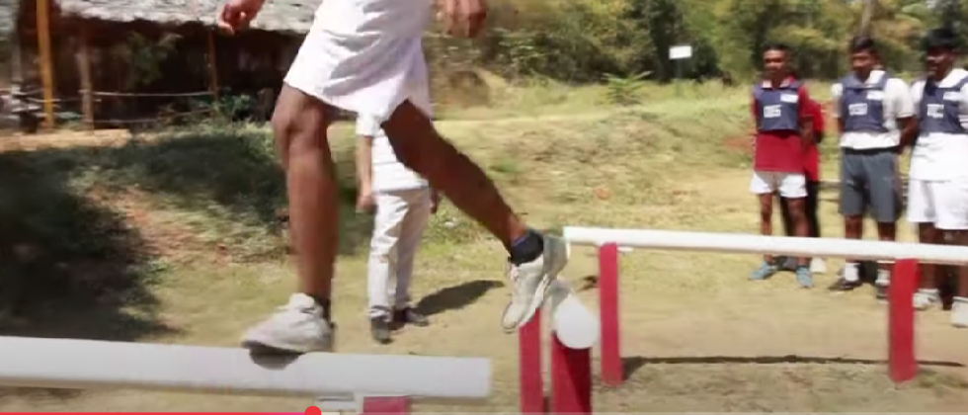
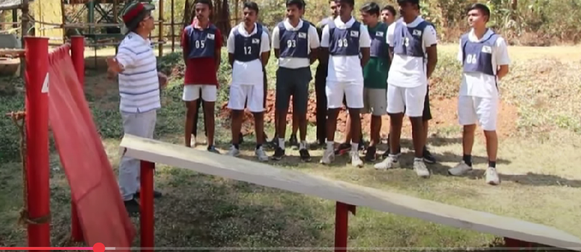
Individual Obstacle

Slide 14
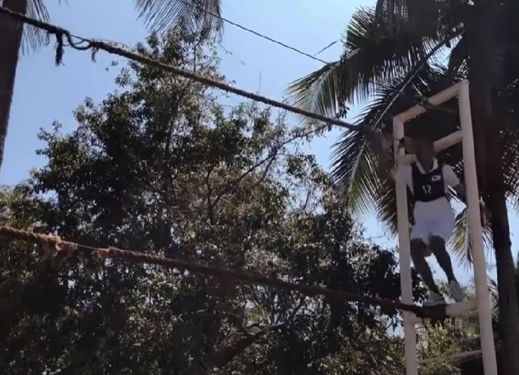
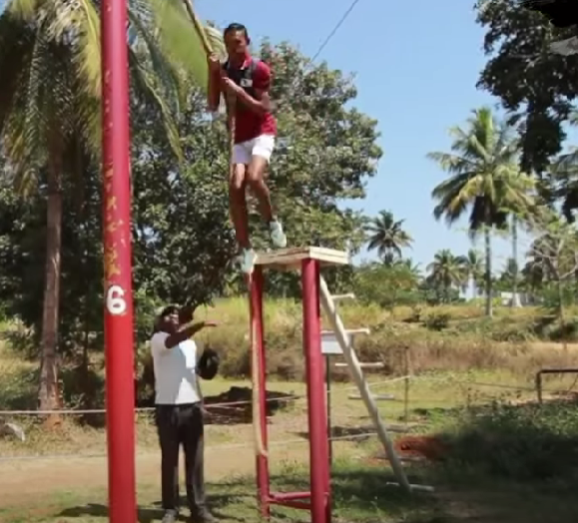

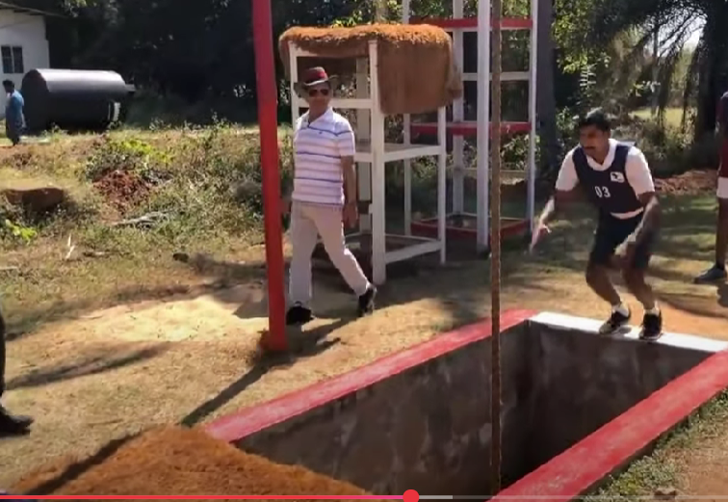
Individual Obstacle

Slide 15
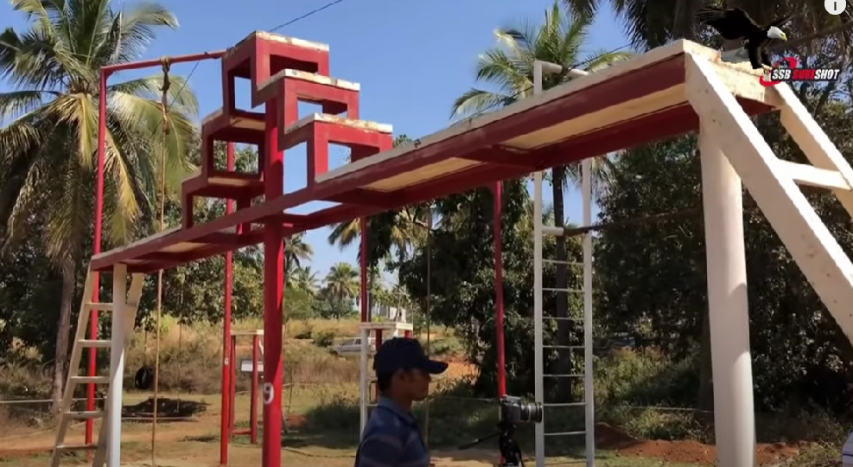

Individual Obstacle

Slide 16
Interview
12
Self awareness
NCC docket
Current Affairs (At least last 6 months)
Geopolitics
Disputes
Terrorism
Geography

Slide 17
Day 5
08
Conference day

Slide 18

Medicals
09
Blood Test Urine Test
Chest X-Ray and Ultrasound
ENT Test (Ear, Nose & Throat)
Surgical Evaluation
Eye
Dental Test
Height, Weight, Heartbeat & Blood Pressure test
Medical Conference

Slide 19
Stay near SSB
10
SSB Allahabad Batch no. tells the board you're going to give SSB for11SSB ------ 35xxx14SSB ------ 71xxx18 SSB----- 38xxx19SSB ----- 39xxx34 SSB----- 46xxx
Stays -- Dharmshala inside SSB (best, 600m from centre,₹200/head call letter mandatory before check-in)- Hotel veenit (₹250)- Dormitory managed by EX army officer, ₹1000 per night, free drop facility in the morning)
SSB Bhopal 20SSB----- 40XXX21SSB----- 72XXX22SSB----- 42XXX
Stays -- Jain dharmshala (800m from centre, ₹200/head, ₹50 for dinner gufa mandir just opposite)- Dev begas sanik aramgruh, 96859 62886, Sardar Vallabh Bhai Patel Polytechnic Chouraha, 45 Bunglows, North TT Nagar, TT Nagar, Bhopal, Madhya Pradesh 462003
SSB Jalandhar31SSB ----- 81XXX32SSB----- 92XXX Stays- Sodhi PG - Bada baba gurdware ke pass, H.No.43, Modern Estate, Near pinky tent house, dakoha, rama mandir, jalandhar - 9872738031, 8437388717 - ₹100/night - Comfort PG - 1km - from centre 700 for single person 900 for 3- Babri Dharmshala - https://goo.gl/maps/kaJXb3CzkxGQvHrP8 - 9878746006- SSB Stay at Jalandhar, Dormitory & PG - 27-B, Beant nagar – 9465331052
SSB Bangalore17SSB ----- 63XXX24SSB ----- 68XXXStays- Sri Sri Ravishankar Bal Mandir, Ashram, 21KM, Kanakapura Rd, opp. Art Of Living Ashram, Jayanagar, Bengaluru, Karnataka 560082 (31km from the centre, ₹150/day)- Hotel townhall (₹650/head)

Slide 20
Stay near SSB
11
4AFSB Varanasi - Om Inn hotel residency (₹700 per head)- Dormitory by Irctc
3AFSB Gandhinagar - Kadva Patidar Samaj, pocket friendly and near to reporting place.- Youth hostel (₹135 per head, dormitory)
5AFSB Guwahati - Royal Arunanchalee Guest
2AFSB Mysore - Ginger Mysore (800m from AFSB BUT ₹₹₹)- Shreyas Residency (₹650 per head,1.3km from the centre)- San en suites (1.5km from the centre)
1AFSB Dehradun - Dolphin guest house (10m from the centre, best,₹1000/person)- Doon valley homestay - Aman guest house (₹500-600)- Hotel Morning Star
NSB Kolkata- (₹300/day food included) Gurudarawara Bara Sikh Sangat, Mallick St, Kesoram Katra, Buraa Bazar, Jorasanko, Kolkata

Slide 21
Stay near SSB
12
CGSB Goa- Dormitory by IRCTC (Do advance booking)
Ahmedabad- Kutchi Jain Sewa Samaj Opp. Arihant nagar Jain Temple, On road, Camp Rd., opp. to Rajasthan Hospital Ahmedabad, Shahibag₹100/day per person dormatory + food facilityhttps://goo.gl/maps/piuFTXhs8LpcZGgP7- BAPS Shri Swaminarayan MandirCamp Rd., Jain Colony, Shahibag₹300/day per person + food facility includedhttps://goo.gl/maps/Vx1EC3wAqxFWVc199- Jawahar Sindhi Dharamshala61, Kubernagar Rd, Kuber Nagarhttps://goo.gl/maps/DxFtf5U3rZAY1sv26- Anand Prakash Maharaj Dharmashala233, Patel Society, Asarwahttps://goo.gl/maps/FqE9zkHTpt9eWs349- Revabai Hindu DharmashalaMyu.Se. 620/55, Old Railway Station, Kalupur Rd, Kalupurhttps://goo.gl/maps/N2BxudHrRa4BAX3RA- Marchipole Jain DharmshalaKalupur, Tankshal, Khadiahttps://goo.gl/maps/GkLuBVvrStTFx9e68- Hindu Dharamshala₹250/day per person16, Relief Rd, Kapasia Bazar, Sakar Bazzar, Kalupurhttps://goo.gl/maps/DwhjknaP8HAJu72eA- Sindhi Dharamshala TrustKotni Rang, near Anand Sweets, Kapasia Bazar, Revdi Bazar, Kalupur₹125/day per person + basic amenitieshttps://goo.gl/maps/JRiCfRAnsNUvgsqNA- Khadia Digambar Jain Dharmshala1798, Old City, Khadiahttps://goo.gl/maps/Bx1Kyjc6bdtYkU7KA

Slide 22
Important documents to keep ready prior to SSB
12
CGOA to % conversion
Bonafide certificate
Domicile/ Residence certificate
Affidavit
Marks card (SSLC, II PUC, Engineering (till previous semester))
ID proofs

Slide 23
Clothing
12
Formals (2 pairs)
White t-shirt and white shorts (men) / white or black track pant (women)
Night wear (2 pairs)
Formal Shoes and belt
White shoes

Slide 24
Stay near SSB
12
CGSB Goa- Dormitory by IRCTC (Do advance booking)
Ahmedabad- Kutchi Jain Sewa Samaj Opp. Arihant nagar Jain Temple, On road, Camp Rd., opp. to Rajasthan Hospital Ahmedabad, Shahibag₹100/day per person dormatory + food facilityhttps://goo.gl/maps/piuFTXhs8LpcZGgP7- BAPS Shri Swaminarayan MandirCamp Rd., Jain Colony, Shahibag₹300/day per person + food facility includedhttps://goo.gl/maps/Vx1EC3wAqxFWVc199- Jawahar Sindhi Dharamshala61, Kubernagar Rd, Kuber Nagarhttps://goo.gl/maps/DxFtf5U3rZAY1sv26- Anand Prakash Maharaj Dharmashala233, Patel Society, Asarwahttps://goo.gl/maps/FqE9zkHTpt9eWs349- Revabai Hindu DharmashalaMyu.Se. 620/55, Old Railway Station, Kalupur Rd, Kalupurhttps://goo.gl/maps/N2BxudHrRa4BAX3RA- Marchipole Jain DharmshalaKalupur, Tankshal, Khadiahttps://goo.gl/maps/GkLuBVvrStTFx9e68- Hindu Dharamshala₹250/day per person16, Relief Rd, Kapasia Bazar, Sakar Bazzar, Kalupurhttps://goo.gl/maps/DwhjknaP8HAJu72eA- Sindhi Dharamshala TrustKotni Rang, near Anand Sweets, Kapasia Bazar, Revdi Bazar, Kalupur₹125/day per person + basic amenitieshttps://goo.gl/maps/JRiCfRAnsNUvgsqNA- Khadia Digambar Jain Dharmshala1798, Old City, Khadiahttps://goo.gl/maps/Bx1Kyjc6bdtYkU7KA

Slide 25


Slide 26

07
Thank you!

